Slide 1


Slide 2
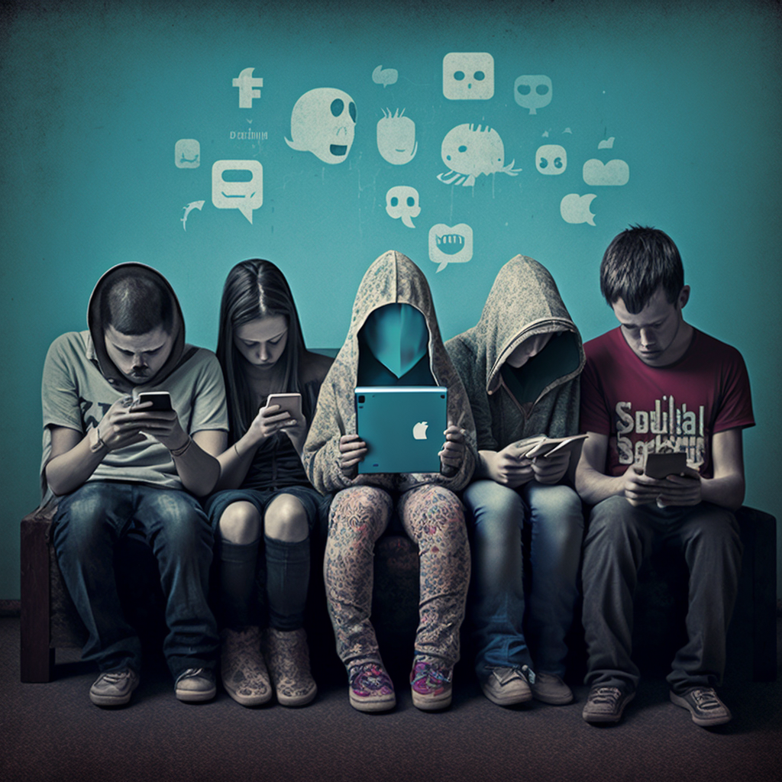
DARK SIDE OF SOCIAL MEDIA

Slide 3
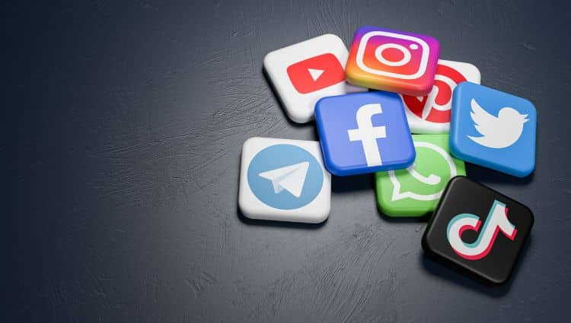
INTRODUCTION
INTRODUCTION
Social media has become a part of everyday life for billions of people worldwide.
Platforms like Facebook, Instagram, Twitter, and YOU TUBE are used for everything from staying connected with loved ones to sharing news and opinions.
Over 4.7 billion active social media users globally.
It shapes our social, cultural, and political landscapes

Slide 4
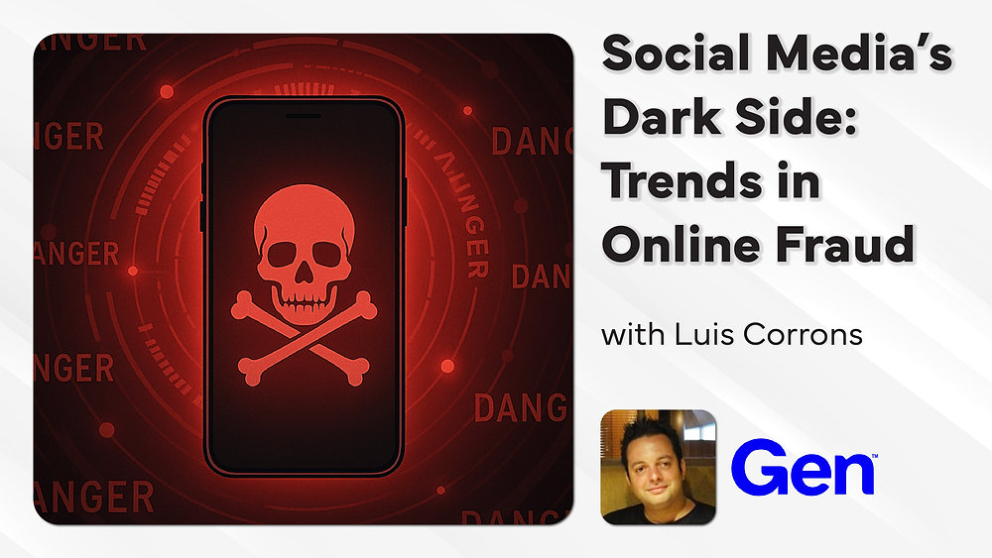
ADDICTION AND TIME WASTAGES
Social media platforms are designed to keep users hooked (endless scrolling, notifications).
Fact: On average, users spend several hours per day on social media.
Negative impact: Decreased productivity, reduced face-to-face interactions.
Distraction: Constant notifications and checking social media during work or study hours.
Decreased Focus: Switching between tasks and apps reduces cognitive performance and focus

Slide 5


Misinformation & Fake News
False news spreads faster than truth
Creates panic, rumors, and confusion in society
Influences elections, politics, and public opinion
Fake health news misguides people (e.g., COVID-19 myths)
Difficult for ordinary users to detect fake content

Slide 6


Social & Lifestyle Impact
Reduces face-to-face conversations & bonding
Excessive use causes sleep disorders
Productivity at school/work decreases
Promotes sedentary lifestyle & health issues
Children exposed to harmful or inappropriate content

Slide 7

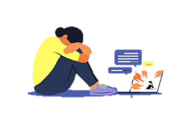
Cyberbullying & Privacy
Online abuse, trolling, and harassment are common
Many youths suffer silently from cyberbullying
Data shared online is often sold or misused
Identity theft, hacking, and fraud risks rise
Users lose control over personal information

Slide 8
Conclusion & Solutions
Social media has benefits but serious risks
Users must be aware of its negative impact
Digital literacy and fact-checking are essential
Limit screen time for healthier balance
Promote responsible usage for a safer online world

Slide 9


